Slide 2



Implementing community based research among transgender people: the case of the SWEETIE and SEXCOHORT projects in Barcelona, Catalonia (Spain)
Jordi Casabona
Scientific Director CEEISCAT
jcasabona@iconcologia.net

Slide 3
Context
The Sweetie and SexCohort Projects
Some results
Some considerations

Slide 4
HIV
Transmission Group distribution for HIV and Syphilis in Catalonia, 2017
SYPHILIS
?
Notes:
Transgender female and male sex workers are vulnerable and hard-to-reach populations.
There is a scarce data on HIV and other STI prevalence and there is no data on HIV/STI incidence among transgender female and male sex workers in Catalonia and Spain.
The determinants of HIV acquisition and health needs among transgender female and male sex workers are seldom studied in Catalonia and Spain

Slide 5

  Trans SW in clinical settings:
  HIV Prevalence: 22% (Navazgo, 2009)
  HIV Incidence: 1,2/100 py (Diez, 2014)
DEVO
Source: CEEISCAT, 2017

Slide 6

General objectives
To describe the socio demographic and epidemiological characteristics of transgender female and male sex workers attending community based services in Barcelona.
To estimate the prevalence of HIV, HPV, Chlamydia trachomatis (CT), Neisseria gonorrhoeae (NG), HBV and HCV among this population.
To describe and identify respectively the use and needs for health services among this population.
A cross sectional study of trangender women and MSM sex workers in Barcelona, recruited in 2 diferents programs addressed to these populations (2017-2018).
Notes:
Recruitment
Promotional information (online or print) were distributed during outreach activities or using social media mobile testing and web-base apps.
An specific online strategy using ads placed on sex work sites has been design to reach sexual workers who do not attend community-based centers (hidden population)
Peer recruitment (snow ball approach)

Slide 7


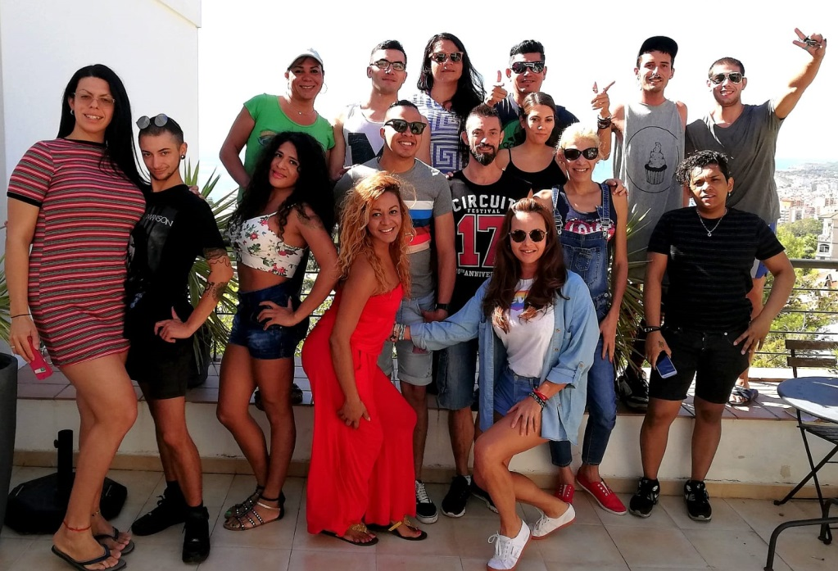

Slide 8


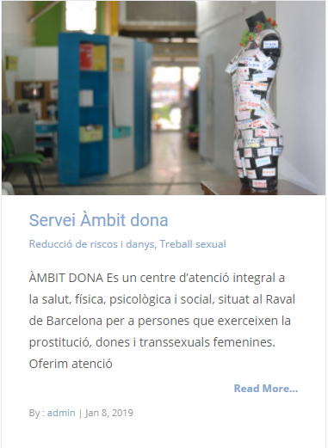
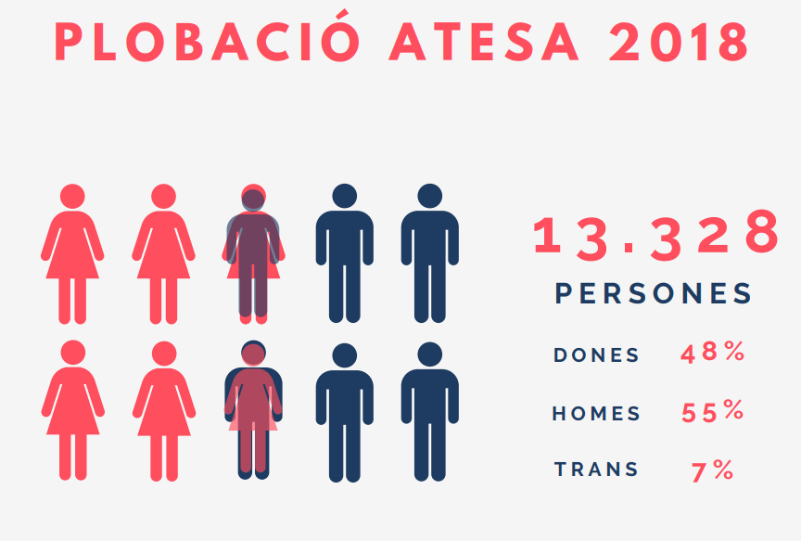
http://realidadtransexual.blogspot.com.es/

Slide 9


MSM N= 47
TRANS W N= 100
82%
97%
Born outside Spain
Born outside Spain
Origen
MAY 2017-MAY 2018

Slide 10
Sex work outside Spain during last 3 months

Slide 11
Having difficulties to find Having difficulties to find Economical need Exiting and easy money
other jobs because I am other jobs because of for other purposes
not In a regular status discrimination

Slide 13
Sexual behaviour with clients by gender
 | MSM | TRANS W | p-valor
Average number of client last week | 5,9 (DE: 5,8) | 9,5 (DE:7,8) | <0,05
Consistent use of condom
Active penetration | 52,3 | 74 | <0,05
Passive penetration | 61,1 | 77,5 | p<0,1

Slide 14
Average number of client
per week
Have a second alternative job
Have experienced violence or discrimination
*p < 0,05

Slide 15
Health Card or Medical Insurance
Residency permit
Residency Permit
*p < 0,05

Slide 16

General objectives
To estimate incidence of HPV and HIV
To identify determinants for these infections
To better describe estructural determinants of vulnerability
To describe mobility paterns and their influence in health/services parameters
A prospective cohort study of trangender women and MSM sex workers in Barcelona, recruited in 4 diferents community based programs addressed to these populations (2019-2021).
6 month periodical clinical and epidemiological assessement over 2 years.
Target sample size : 300

Slide 17
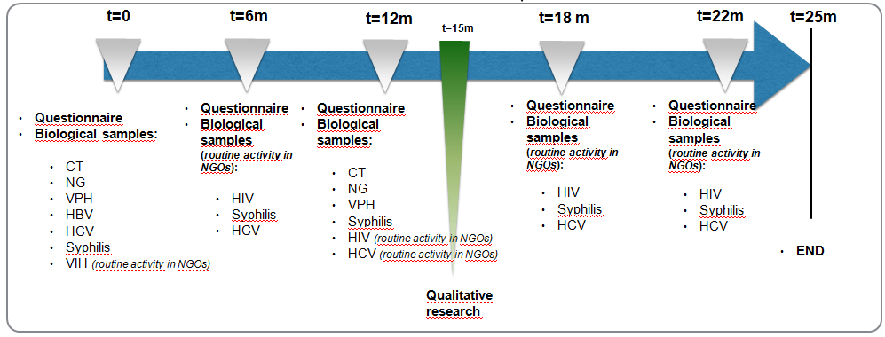
VIH: rapid test . VPH: venipuncture and oral, anal, perianal and penis sample. CT y NG: urine, pharynx and anal sample. VHB, VHC and Syphilis: venipuncture
Notes:
Active follow-up:
Strategies using social media, mobile texting, and web-based apps
Incentives at each visit
Individual contacts with participants for feed-back, planning the appointments

Slide 18
In our setting MSM SW and TRANS W SW are a difficult to access population; to have enough large sample sizes is not easy. Complementary recruitment strategies needs to be in place and community based programs run by peers are crucial to access them and eventually to link them to the formal Health System.
The study population is basically foreigner, mainly from LA countries and moreover they tend to work in different cities and countries. Cultural diversity, mobility and structural factors associated to migration needs to be taken into account for both study design and health care services; ad hoc procedures for adherence to programs and services need to be studied.
Although the level of exposure to HIV is high among both MSM and TRANS SW, social-economical determinants, use of preventive measures and needs differs, TRANS SW W having less social networks and more barriers. Risk and morbidly are associated to social determinants and legal status. Structural determinants needs to be better identified and understood for intervention purposes. To facilitate mechanisms to access health services regardless of the legal status, should be an important part of the response.

Slide 19
4.- In our setting, MSM and TRAN W SW have a high level of exposure and social vulnerability and
therefore a high prevalence of HIV and NG (syphilis was not studied in Sweetie). MSM SW and TRANS W
SW should be considered a specific target population for preventive interventions and this
population needs to be identified in the M&E information systems for evaluation purposes.
5.- The collaboration between academia and peer NGOs has not only made possible the
implementation of the study, but also it has contribute to systematize programmatic data
collection and eventually to increase efficiency and effectiveness of their services. NGOs and
peers needs to be involved in all phases of the studies to assure feasibility and effectiveness.

Slide 20
Community based Socio-Epidemiological and Program Science Research

Slide 21
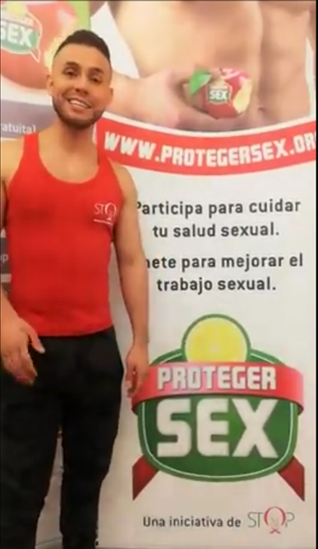

Thanks
Acknowledgement: full team from Stop Sida, Ambit Prevenció and CEEISCAT, in particular Cinta Folch, Joselyn Mesia and Laia Ferrer

